Slide 1
Talk To Me JAWS!
10 Tips To Make Documents More Screen Reader Friendly
Elizabeth Whitaker
Cori Perlander
Manager, User Education & Outreach
Manager, Sales Enablement

Slide 2
What You Will Learn
What it means to have a usable document for a screen reader
Top 10 practical tips from screen readers
The impact
JAWS Examples
Resources

Slide 3
Screen Reader Friendly Doc Means...
Equal Access to Information: Ensures individuals using screen readers can perceive and understand the same content as everyone else.
Seamless Interaction: Enables users to navigate, input data, and engage with digital documents without barriers.
Full and Independent Use: Allows individuals with disabilities to utilize services without limitations, ensuring equal participation.

Slide 4
Top 10 Tips from Screen Readers

Slide 5
1 - Use Numbered and Bulleted Lists
Logical, easy to understand and navigate.
Screen readers can skip over lists, more efficient
SOLUTION:
Use a numbered list to convey steps in a process or number of parts.
Use a bulleted list to convey related items.

Slide 6
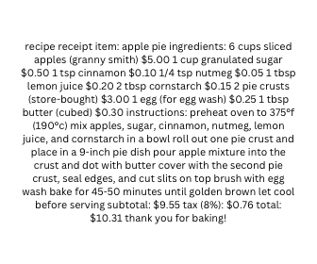
Impact: Find The Ingredients
This is what a screen reader has to work with when there are no bulleted or numbered list.

Slide 7
2 - Apply Headings Styles
Signify titles and sections within a document.
Crucial for screen reader users to navigate efficiently.
Visually styled text without h tags will not be recognized as a heading by JAWS.
Solution
To ensure proper recognition and readability, always use h tags.

Slide 8

Impact: Lifestyle Section?
This is what a screen reader has to work with when there are not appropriate heading styles.

Slide 9
3 - Use Table Headers
Tables without proper headers make data difficult to interpret.
SOLUTION:
Use table headers by selecting option to "repeat as header" when creating table
JAWS will announce the number of columns and rows.
Table headings will be read as users navigate, making the data easy to understand.

Slide 10

Impact: Electricity Over $500?
When a table does not have headings, it’s like navigating through individual sticky notes, and much of the information is still not there.

Slide 11
4 - Use Clear Form Labels
Form fields are controls you interact with in a form.
Examples are edit boxes, drop-down boxes, check boxes, and buttons.
If unlabeled, screen readers won’t hear required information.
SOLUTION:
Use label tags for each control.
Use clear language to describe the purpose of each control.
Clearly labeled controls enable faster navigation.
Ensures users will enter the correct information when filling out forms

Slide 12

Impact: Where Do You Put Date of Birth?
When form fields are not tagged, screen readers have no idea what information is being requested.

Slide 13
JAWS Examples

Slide 14
5 - Alternative Text
Describes images to users who cannot see them.
Helps users understand the content and purpose of the image.
Depicts important information included in graphs, charts, and photos.
SOLUTION:
Provide concise and informative ALT text for every valuable image to convey the meaning or function it provides.
Decorative images don't require descriptions.

Slide 15
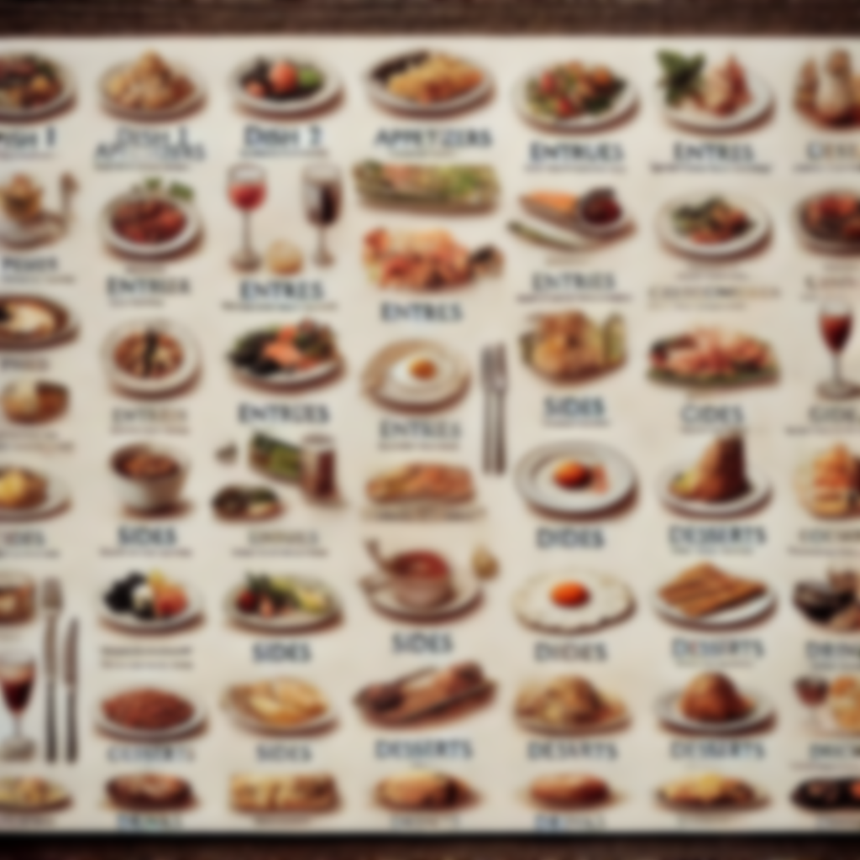
Impact: May I Take Your Order?
With no alt text, a screen reader has to ask for help.

Slide 16
6 - Use Inline Images
Images should be inline with the text rather than floating.
Floating images do not align with the document text.
When this occurs, a screen reader user will not know the images are present- even if the image has alt text.
SOLUTION:
Select this setting in layout options

Slide 17
Impact: As You Can See Here...
When a document does not have inline images, a screen reader has no idea the image is there.
Blank slide
This is a picture of a beautiful rose garden on a sunny day with roses blooming with shades of pastels, and everyone can see this except for you.

Slide 18
7 - Use Descriptive/ Meaningful Links
Descriptive links provide context about where the link points.
Example, Freedom Scientific Blog
Avoid link text such as “click here” or “more.”
Do not include the word “link” in the text, as JAWS already announces the presence of a link.
SOLUTION:
Use link text that clearly and concisely conveys the title or content of the page being pointed to.

Slide 19
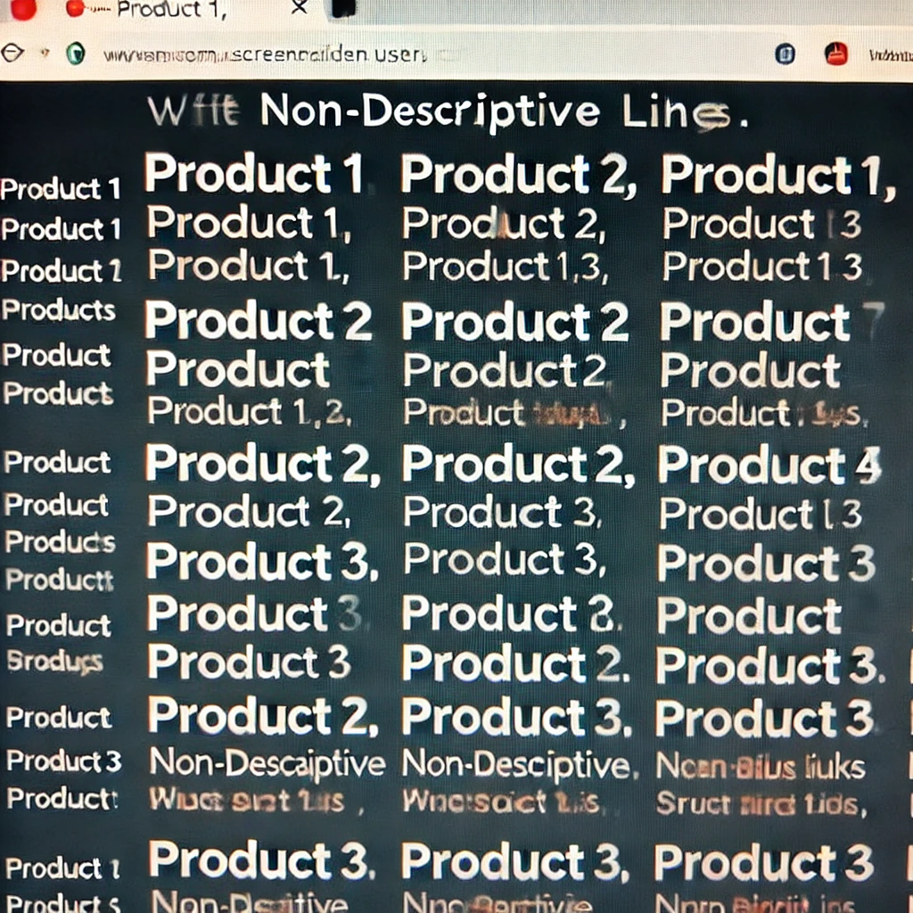
Impact: Favorite Shirt?
When links are not descriptive, it’s a guessing game for a screen reader. They must click around until they land in the right place.

Slide 20
Live JAWS Examples

Slide 21
8 - Complete Required Doc Properties
Specifying a title allows for easier identification.
Document is more searchable.
Title is spoken when switching apps or when invoking Insert + T
Title will be spoken at the beginning of a PDF
SOLUTION:
Provide a concise, descriptive title.
Provide a short description of the document content.

Slide 22
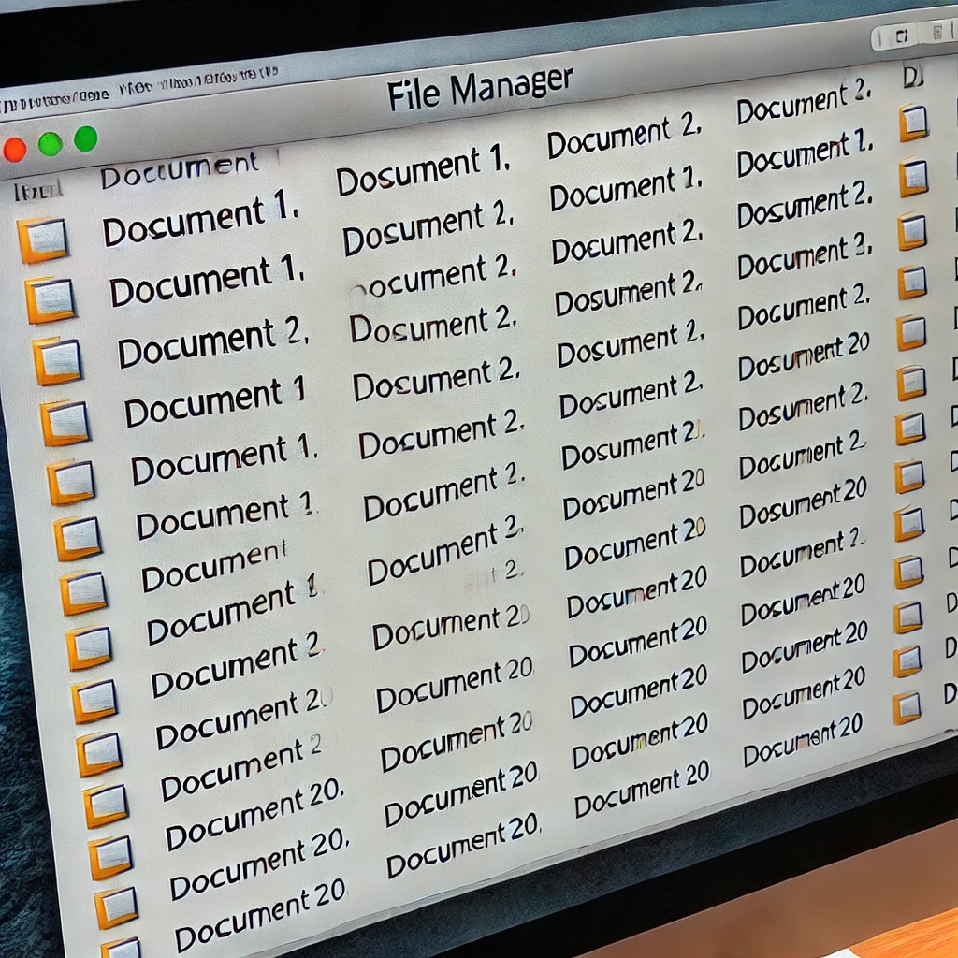
Impact: Find Meeting Notes
If a title is not completed in document properties, it makes it difficult for a screen reader to know where to find that document or when they are in that document.

Slide 23
9 - Ensure Correct Tab and Reading Order
For sighted users, the logical order of a PDF is the visual order on-screen.
When using assistive technology, the tab order determines the order users can navigate the content.
Content includes text, interactive elements, form fields, and links.
Tab order must reflect the logical order of the document.
Reading order is determined by tag order of elements.
The order of content in individual tags is determined by the document content tree structure.
Logical structure is created when a document is a tagged PDF.

Slide 24
9 - Ensure Correct Tab and Reading Order 2
If reading order is not correct, users may not be able to understand the content.
Example, the use of multiple columns
Visually, reading order makes sense as flowing from the top to bottom of one column, then on to the next.
If not properly tagged, a screen reader may read from top to bottom across both columns as if there is only one column.
SOLUTION:
Use a PDF authoring tool to set tab and reading order

Slide 25
Impact: Now Sing!
Up above the world so high,
How I wonder what you are!
Twinkle, twinkle, little star,
Like a diamond in the sky.
If the tabbing order does not flow as the text does visually, content is scrambled; therefore, completely out of context.

Slide 26
Live JAWS Examples

Slide 27
10 - Use Built-in Accessibility Checker
Use the built-in accessibility checker
Once the automated check is complete, manually review and make corrections.
The accessibility checker WILL NOT find all accessibility issues- yet it's more efficient to let the automate tool take care of the low lying fruit.

Slide 28
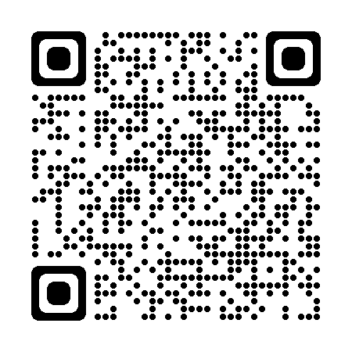
Resources
Visit the Freedom Scientific Resources page
https://www.freedomscientific.com/resources

Slide 29
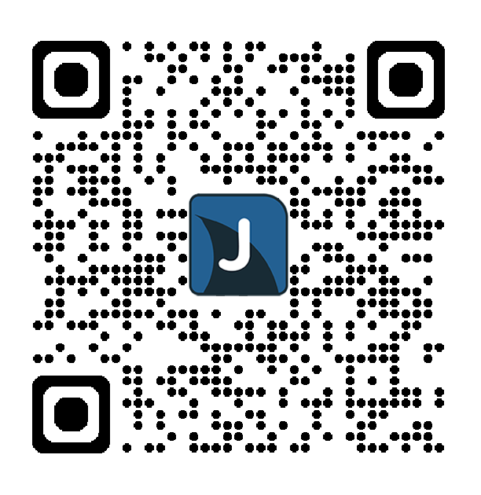

Introducing the Insert + J Club!
Learn More and Sign Up at FreedomScientific.com/InsertJClub
Connecting JAWS users worldwide
Exclusive content for members
Virtual social events
In-person meet and greets at various conventions
Opportunity to give targeted feedback on products
Early access to what’s new in product releases
SIGN UP BEFORE MARCH 15th TO BE ENTERED INTO A DRAWING FOR 90 FREE MINUTES WITH AIRA!

Slide 30
Questions?

