Slide 1

JAWS Inspect Onboarding:
Taking A Bite Out Of JAWS Testing
Mike DeSorda
Customer Success Manager

Slide 2

Obstacles When Conducting
Manual Accessibility Testing
Screen Readers are rich in features for end users, not applicable to testers:
  Steep learning curve to configure and operate -- many keyboard shortcuts.
  Manually file bugs for tracking with only voice output
  Challenging to collect consistent, reliable results
  Difficult to multi-task using synthetic speech

Slide 3
Building An Inclusive Bridge Between Assistive Technology and Manual Testing
JAWS Inspect vastly simplifies accessibility and JAWS compatibility testing.
No synthetic speech or the complex feature set of the end-user product for the sighted developer or tester.
Fully accessible for vision impaired users to communicate with sighted peers.
Uses transcripts of JAWS output to quickly diagnose issues and share them easily across quality control and compliance systems.

Slide 4

Benefits
Simplifies assistive technology use for testers
Text transcript of JAWS output for use in bug tracking and compliance programs
Mouse and/or keyboard interface
Real-time identification of issues
Rapid rollout with limited training required
Demonstrates immediate impact of accessibility on users

Slide 5

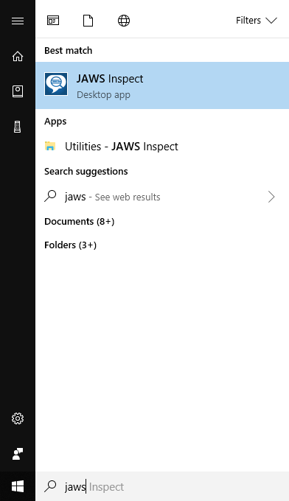
Launching JAWS Inspect
5
Standard Windows application that can be ran on stand-alone Windows Machines, servers, and Macs via a Windows VM. Client responsible to set up the W VM; TPGi can support install as needed.
Launch it from the Start menu or a program shortcut on a desktop

Slide 6

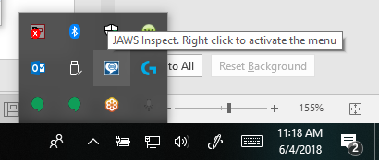
Using JAWS Inspect
6
The only persistence of JAWS Inspect you will see is a system tray icon
To launch JAWS Inspect, hold down your CTRL key and right-click the mouse (or use the context menu key)
The JAWS Inspect menu will appear on the current page in your browser

Slide 7
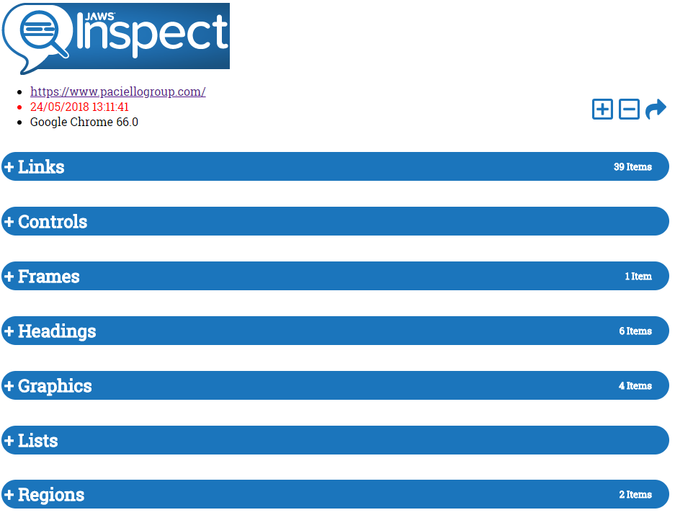
Full Page Report
  The full report details the JAWS speech output for a single page.
  Organized by
  element
  Easy export to CSV or JSON

Slide 8
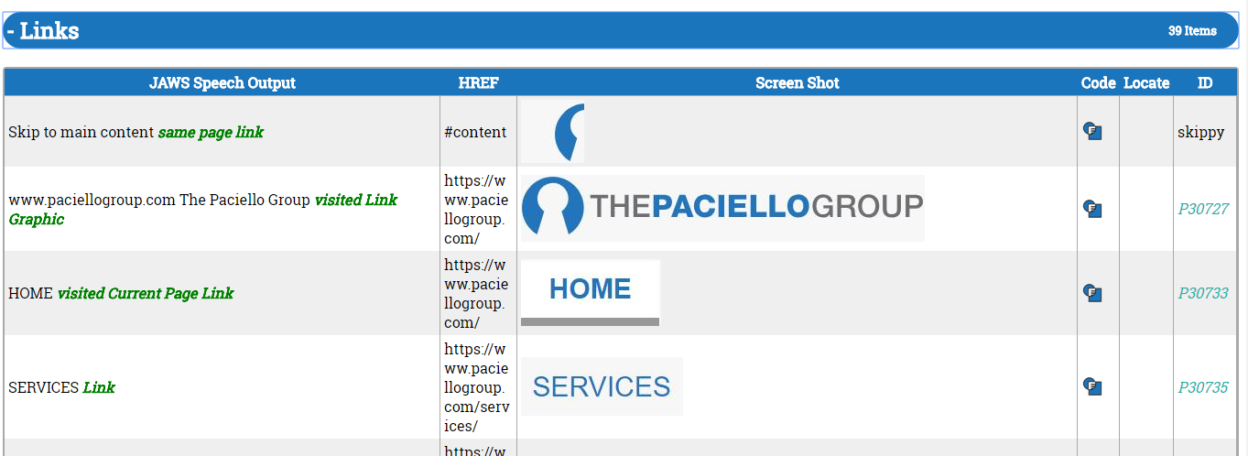
View JAWS Output for HTML Elements
View JAWS Speech output (green/italic text indicates screen reader extra verbosity)
Screenshot of relative element location
Element ID

Slide 9
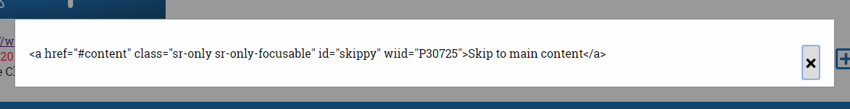
View Code Snippet for Single Elements
View code snippet of each element as well

Slide 10
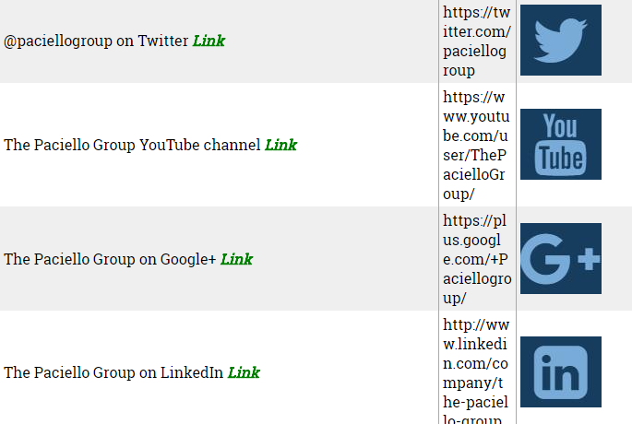
Issues Clearly Shown
A clear visual illustration of what screenreader experience on your site
No need for screenreading expertise to read and understand reports

Slide 11
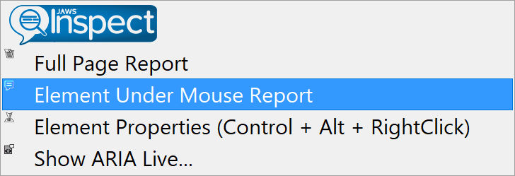
Element Under Mouse Report
Run the same report on one element on the page (smaller condensed report for a single element)

Slide 12
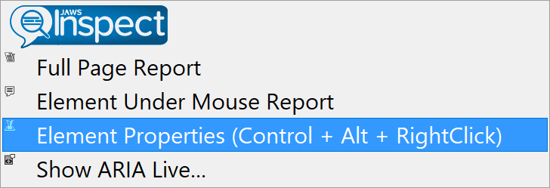
Element Properties
No need to try and locate an element with JAWS
Stay within your current browser tab, can help when troubleshooting individual components

Slide 13
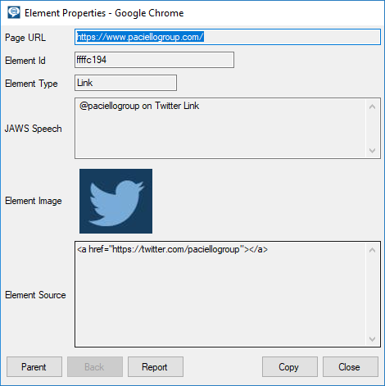
Focus on the Element
  Speech output
  Extra information supplied by JAWS to the user in Bold, Italic format
  Screenshot
  Code
  Navigate the DOM tree and find the same information for parent elements

Slide 14
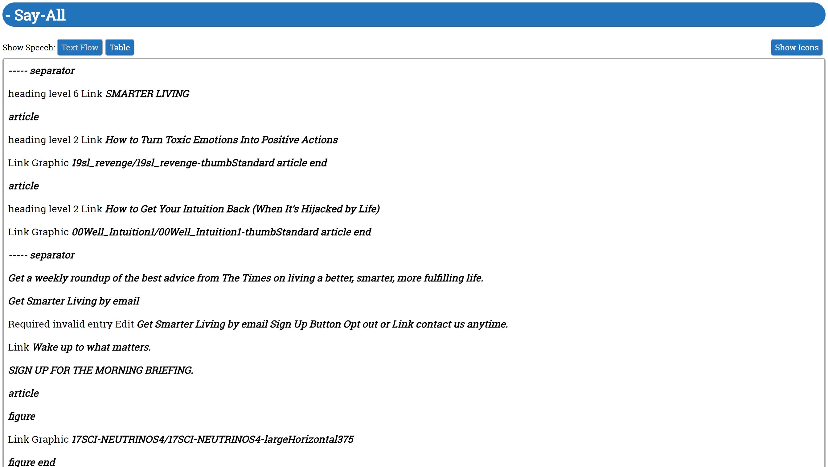
Say All Report
Provides a linear view of JAWS speech, reflecting the content order on the page.
Compare the JAWS output to the source to spot differences or elements that are not spoken.

Slide 15
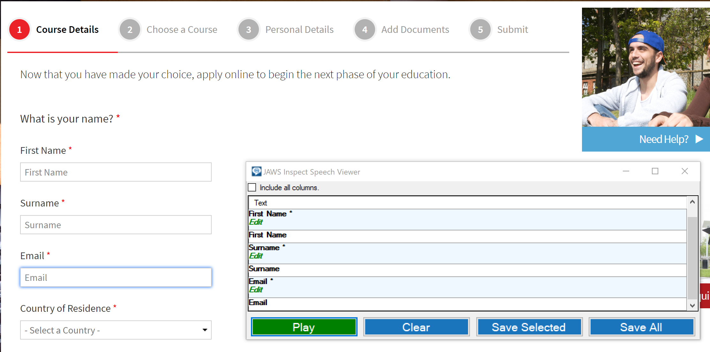
Live Testing With The Speech Viewer
Provides a live log of JAWS Speech.
Pause and restart sessions to capture just the part of the page or application that you want.
Log speech for workflows or specific tasks.
Useful for testing HTML content, web apps, and PDF documents.

Slide 16
JISpeak for Automated
Speech Viewer Testing
JISpeak automatically stops and starts speech capturing
Automatically saves speech transcript
Helpful for running with automated test scripts of web content
Use hotkeys to “start” and “stop” recording

Slide 17
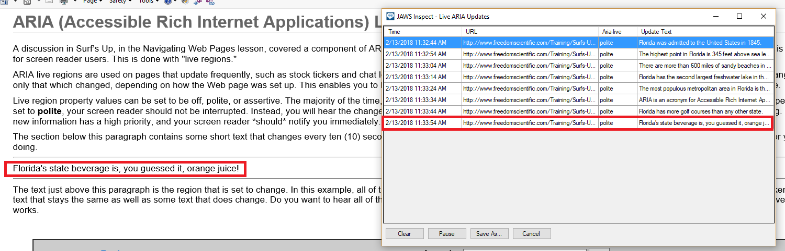
ARIA Live
Rapidly test ARIA Live regions without using a screen reader
Helpful for testing error messaging in forms that use ARIA Live
Capture updated screenreader output in real-time

Slide 18
FAQs
Does JAWS Inspect require JAWS to be installed or running on the machine?
    No, it is a completely standalone application
Which browsers does JAWS Inspect support?
    Microsoft Edge, Chrome, FireFox, and Internet Explorer 11
Which operating systems are supported?
    Effectively the same as JAWS, so Windows based operating systems
Does JAWS Inspect identify compliance failures?
    JAWS Inspect will provide a report of what JAWS users will experience on your site but does not identify code level issues.

Slide 19
FAQ Continued
What is the sales model?
    JAWS Inspect is an annual, subscription-based license.
What license types are available?
    Workstation (seat based) and Network (concurrent).
Do I have to pay for upgrades?
    Upgrades are provided free of charge for current customers during the active subscription period.
How is JAWS Inspect installed?
    After purchase, our Sales team will provide you with a serial number,
    authentication code and download link for the product.

Slide 20
Conclusion
Streamline manual testing process to uncover accessibility issues
Rapid rollout with limited training required
Easily export data to CSV or JSON
Track and remediate usability defects
Provide consistent results between sighted testers and savvy end users.
Increase ability to test more content (time is money!)

Slide 21

Questions

