Slide 1

ADA Legal Update: What Your Restaurant Needs to Know About Digital Accessibility
April 20, 2023

Slide 2
Legal Disclaimer
This presentation has been prepared by Seyfarth Shaw LLP for informational purposes only. The material discussed during this webinar should not be construed as legal advice or a legal opinion on any specific facts or circumstances. The content is intended for general information purposes only, and you are urged to consult a lawyer concerning your own situation and any specific legal questions you may have.

Slide 3



Speakers
Minh Vu Seyfarth Shaw
mvu@seyfarth.com
Ashley Jenkins Seyfarth Shaw
asjenkins@seyfarth.com
Matt Ater Vispero
mater@vispero.com

Slide 4
Agenda
01 | Why Digital Accessibility Matters?
02 | Overview of ADA Title III Requirements
03 | National Lawsuit Numbers and Hotspots
04 | The Biden Administration – DOJ
05 | Digital Access Issues for Restaurants
 | Who can file an ADA Title III lawsuit? Websites & Mobile Apps Strategies for Avoiding/Defending Website/Mobile App Litigation Kiosks for ordering/payment Drive thru process Action Items

Slide 5
Why Digital Accessibility Matters?​
Worldwide ​​
One billion people (15% of the world population) have a disability​​
In the United States ​​
Approximately 61 million adults live​​ with disabilities*​​
26% of adults in the United States have some type of disability (1 in 4)*​​
Studies in the US have shown 50% of people with disabilities are online every day. People with disabilities have a purchasing power of $490 billion**​​
When these users have a positive experience, they are more likely to become regular customers and recommend your organization to friends and family​​
*CDC: Updated - October 28, 2022​​
**Air.org Updated - 2018​​
Notes:
Matt

Slide 6
Overview of ADA Title III Requirements
Notes:
Ashley

Slide 7
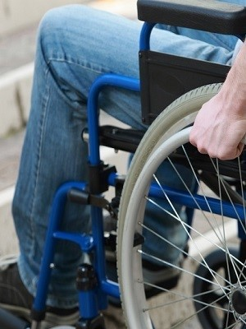
ADA Background
Under Title III of the ADA, public accommodations must:
have facilities that are accessible to individuals with disabilities (i.e., members of the public) and maintain them;
make reasonable modifications to policies, practices, and procedures when necessary to ensure that individuals with disabilities have equal access to public accommodations’ goods, services, facilities, privileges, advantages, and accommodations; and
ensure effective communication with individuals with disabilities by providing them auxiliary aids and services at no additional charge.
Remedies:
Private party: Injunctive relief, attorneys’ fees & costs (possible damages/penalties under state corollary laws)
DOJ Action: Penalties $111,614.00 for a first violation and $223,229 for a subsequent violation; injunctive relief, damages
Notes:
KL #s above are for DOJ penalty assessed after 12/13/21 Up from $96384 and $192768 for penalty assessed after 6/19/2020

Slide 8
ADA Background (Cont.)
What is a public accommodation?
Private business
Affects commerce
Falls within at least one of the following 12 categories:
Places of lodging (e.g., inns, hotels, motels)
Establishments serving food or drink (e.g., restaurants and bars);
Places of exhibition or entertainment (e.g., motion picture houses, theaters, concert halls, stadiums);
Places of public gathering (e.g., auditoriums, convention centers, lecture halls);
Sales or rental establishments (e.g., bakeries, grocery stores, hardware stores, shopping centers);
Service establishments (e.g., laundromats, dry-cleaners, banks, barber shops, beauty shops, travel services, shoe repair services, funeral parlors, gas stations, offices of accountants or lawyers, pharmacies, insurance offices, professional offices of health care providers, hospitals);
Public transportation terminals, depots, or stations (not including facilities relating to air transportation);
Places of public display or collection (e.g., museums, libraries, galleries);
Places of recreation (e.g., parks, zoos, amusement parks);
Places of education (e.g., nursery schools, elementary, secondary, undergraduate, or postgraduate private schools);
Social service center establishments (e.g., day care centers, senior citizen centers, homeless shelters, food banks, adoption agencies); and
Places of exercise or recreation (e.g., gymnasiums, health spas, bowling alleys, golf courses).

Slide 9
National Lawsuit Numbers and Hotspots

Slide 10
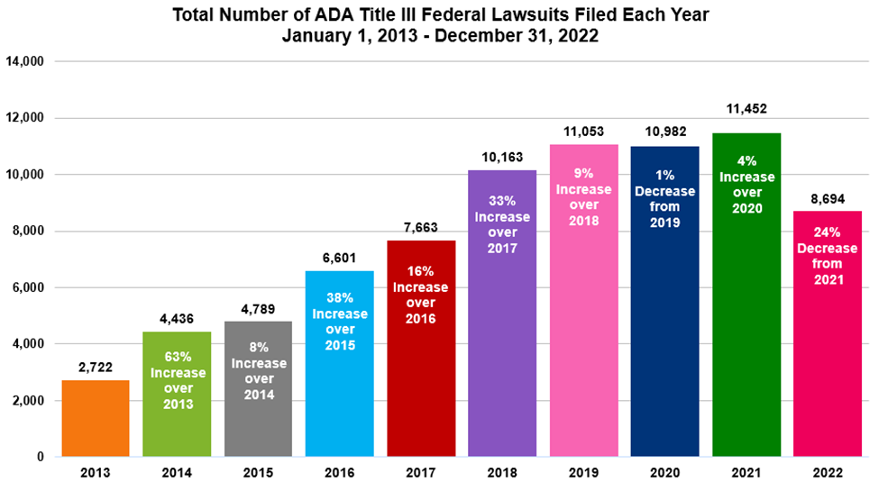
ADA Title III Accessibility Lawsuit Numbers (All Bases)
Notes:
[Total Number of ADA Title III Federal Lawsuits Filed Each Year January 1, 2013 – December 31, 2022: 2013: 2,722; 2014: 4,436 63% increase over 2013; 2015: 4,789 8% increase over 2014; 2016: 6,601 38% increase over 2015; 2017: 7,663 16% increase over 2016; 2018: 10,163 33% increase over 2017; 2019: 11,053 9% increase over 2018; 2020: 10,982 1% decrease from 2019; 2021: 11,452 4% increase over 2020; 2022: 8,694 24% decrease from 2021]

Slide 11
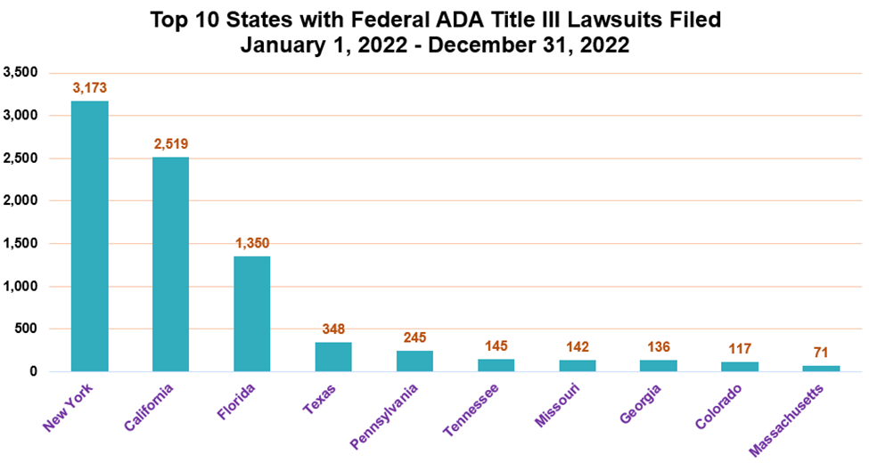
ADA Title III Lawsuit Numbers (All Bases) – Top 10 States
Notes:
[Top 10 States with Federal ADA Title III Lawsuits Filed January 1, 2022 – December 31, 2022: New York: 3,173; California: 2,519; Florida: 1,350; Texas: 348; Pennsylvania: 245; Tennessee: 145; Missouri: 142; Georgia: 136; Colorado: 117; Massachusetts: 71]

Slide 12
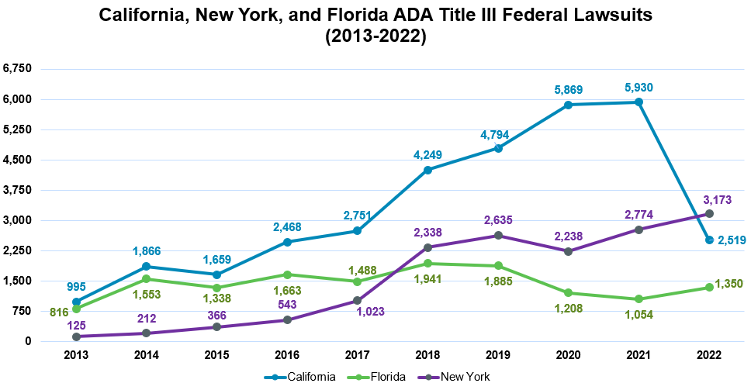
ADA Title III Lawsuit Numbers (All Bases) – The Big 3
Notes:
[California, New York, Florida ADA Tile III Federal Lawsuits 2013-2022: California: 2013: 995; 2014 1,866; 2015: 1,659; 2016: 2,458; 2017: 2,751; 2018: 4,249; 2019: 4,794; 2020: 5,869; 2021: 5,930; 2022: 2,519; Florida: 2013: 816; 2014: 1,553; 2015: 1,338; 2016:1,663; 2017: 1,488; 2018: 1,941; 2019: 1,885; 2020: 1,208; 2021: 1,054; 2022: 1,350; New York: 2013: 125; 2014: 212; 2015: 366; 2016: 543; 2017: 1,023; 2018: 2,338; 2019: 2,635; 2020: 2,238; 2021: 2,774; 2022: 3,173]

Slide 13
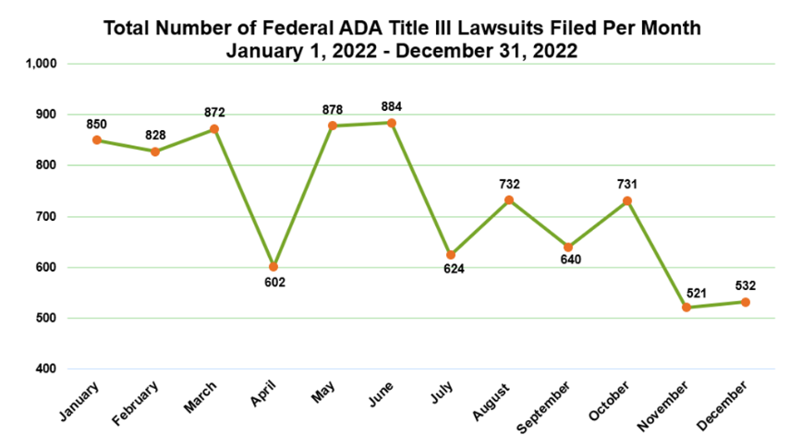
ADA Title III Lawsuit Numbers (All Bases) - Per Month
Notes:
[Total Number of Federal ADA Title III Lawsuits Filed Per Month January 1, 2022 – December 31, 2022: January: 850; February: 828; March: 872; April: 602; May: 878; June: 884; July: 624; August: 732; September: 640; October: 731; November: 521; December: 532]

Slide 14
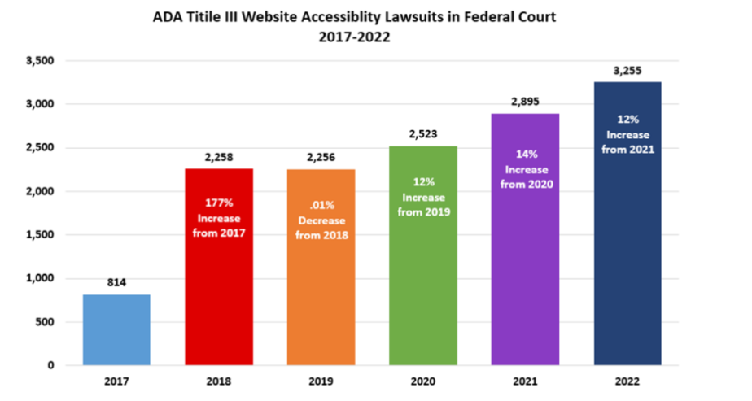
ADA Title III Website Accessibility Lawsuit Numbers
Notes:
[Graph: ADA Title III Website Accessibility Lawsuits in Federal Court 2017-2022: 2017: 814; 2018: 2,258 (177% increase from 2017); 2019: 2,256 (.01% decrease from 2018), 2020: 2,523 (12% increase from 2019); 2021: 2,895 (14% increase from 2020); 2022: 3,255 (12% increase from 2021). *The number of cases that could be identified through a diligent search.]
these website accessibility lawsuits made up a whopping 37% of the ADA Title III lawsuits filed in 2022, up from roughly 25% in 2021.

Slide 15
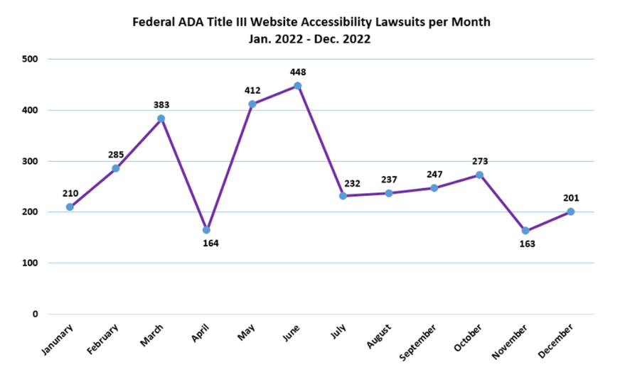
ADA Title III Website Lawsuit Numbers: By the Month
Notes:
[Graph: Total Number of Website Accessibility Lawsuits Filed by Month (Jan. 2022 – Dec. 2022): Jan. 2021 (210), Feb. 2021 (285), Mar. 2021 (383), Apr. 2021 (164), May 2021 (412), Jun. 2021 (448), Jul. 2021 (232), Aug. 2021 (237), Sep. 2021 (247), Oct. 2021 (273), Nov. 2021 (163), Dec. 2021 (201). *The number of cases that could be identified through a diligent search.]The first half of 2022 saw a steady climb from 210 in January to 383 in March, a dip to 164 in April, then spikes at 412 and 448 in May and June. The monthly numbers were more consistent at between 232-273 in July through October, with a dip to 163 in November, before a December finish of 201.

Slide 16
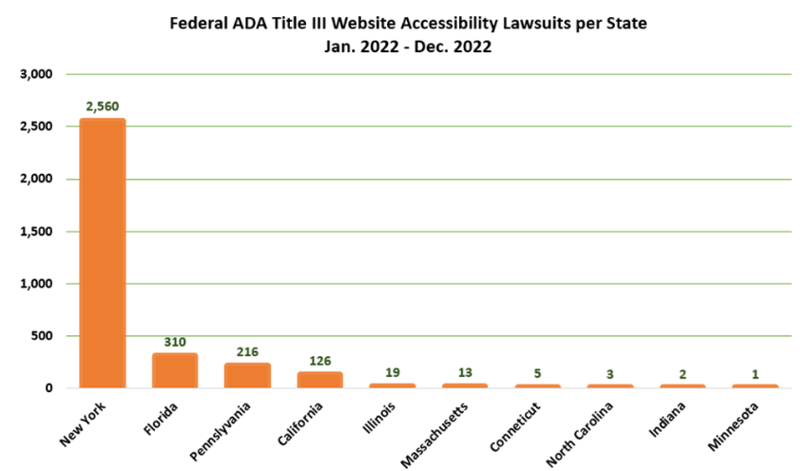
ADA Title III Web Lawsuits by State: Top 10 in 2022
Notes:
[Graph: Top 10 States for Federal ADA Title III Website Accessibility Lawsuits 2022: NY 2,560, FL 310, PA 216, CA 126, IL 19, MA 13, CT 5, NC 3, IN 2, MN 1. *The number of cases that could be identified through a diligent search.]
New York, Florida, and California federal courts continued to be the busiest by far, with Florida regaining the #2 spot and Pennsylvania besting California for the #3 spot. New York federal courts continued to be bombarded with lawsuits, totaling 2,560 lawsuits in 2022 (continuing an upward trend from 2,074 in 2021, 1,694 in 2020, 1,354 in 2019, and 1,564 in 2018). Florida was a distant second with 310 lawsuits. California federal courts saw only 126 lawsuits in 2022 (halting the prior upward trend of 359 in 2021, 223 in 2020, 120 in 2019, and 10 in 2018), as shown in the chart below. Pennsylvania passed the 200 mark at 216 in 2022, materially up from 167 lawsuits filed in 2021 and 173 in 2020. Illinois retained the #5 spot with 19 suits—considerably fewer than its 34 in 2021 and 32 in 2020 and 91 in 2019). Connecticut and Indiana remained in the top 10 with relatively meager numbers at 5 and 2, respectively, and newcomers Massachusetts, North Carolina, and Minnesota beat out Oregon and Wisconsin for the final 3 top 10 spots, with 13, 3, and 1 filings, respectively.7), Sep. 2021 (247), Oct. 2021 (273), Nov. 2021 (163), Dec. 2021 (201). *The number of cases that could be identified through a diligent search.]

Slide 17
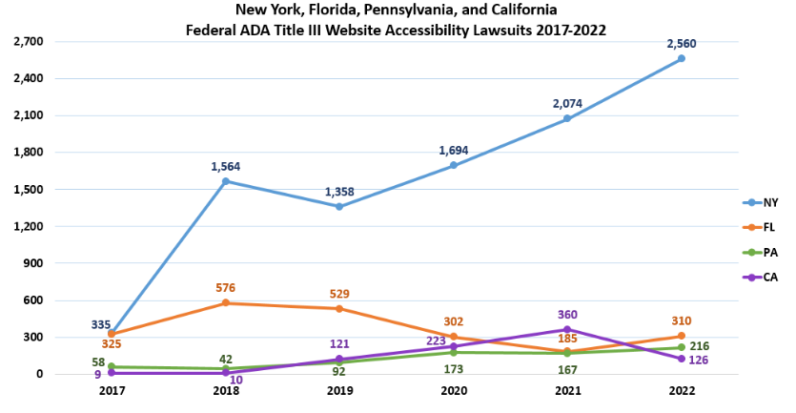
ADA Title III Web Lawsuits by State: Top 4 2017-2022
Notes:
[Graph: New York, Florida, Pennsylvania, and California Federal ADA Title III Website Accessibility Lawsuits 2017-2022: NY: 2017 (335), 2018 (1,564), 2019 (1,358), 2020 (1,694), 2021 (2,074), 2022 (2,560); FL: 2017 (325), 2018 (576), 2019 (529), 2020 (302), 2021 (185), 2022 (310); PA: 2017 (58), 2018 (42), 2019 (92), 2020 (17
If you’re wondering why California has so few website accessibility cases relative to New York, it is likely because New York courts have been more favorable toward plaintiffs, especially when the defendant is an online-only business. Whether online only businesses are covered by the ADA remains unanswered by the Court of Appeals for the Second Circuit; however, with a few exceptions, district court judges in New York that have addressed the issue have found that online only businesses are covered by the ADA. 3), 2021 (167), 2022 (216); CA: 2017 (9), 2018 (10), 2019 (121), 2020 (223), 2021 (360), 2022 (126).]

Slide 18
The Biden Administration DOJ
Notes:
minh

Slide 19
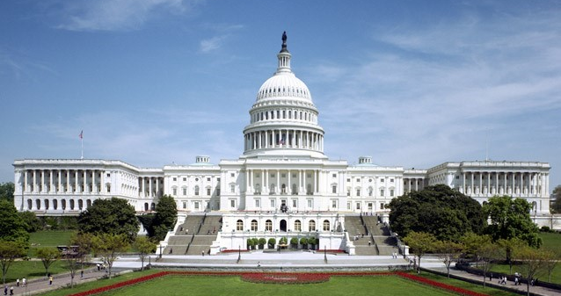
Biden Administration Digital Access Enforcement
Statements of Interest filed about self-service kiosk
Consent Decrees addressing the accessibility of COVID-19 vaccination web portals using WCAG 2.1. AA (RiteAid, Hy-Vee, Kroger, CVS)
Consent Decree for UC Berkeley website
©2023 Seyfarth Shaw LLP. All rights reserved. Private and Confidential

Slide 20
Digital Access Issues for Restaurants

Slide 21
Who can file an ADA Title III lawsuit?

Slide 22
SCOTUS To Address Serial Plaintiff Tester Standing
No need to have desire to patronize business to have standing to sue
Laufer v. Acheson (1st Cir, 2022) (Petition for Certiorari granted)
Laufer v. Arpan (11th Cir. 2022)
Laufer v. Naranda Hotels (4th Cir. 2023) (just decided 2/15/23)
Encountering a barrier on a website or at a location is not enough; there must be downstream consequences
Laufer v. Mann Hospitality (5th Cir. 2021)
Laufer v. Looper (10th Cir. 2022)
Harty v. West Point Realty (2d Cir. 2022)

Slide 23
Websites & Mobile Apps

Slide 24
Accessible Public Facing Technology in Restaurants
Business website/mobile app
Third-party reservations website
PDF menus/QR Codes
Notes:
Accessibility for Ontarians with Disabilities Act
https://www.ontario.ca/page/how-make-websites-accessible
Note: AODA 1/1/21 deadline for making all private websites (of entities having more than 50 employees) accessible extended
Compliance deadline
Beginning January 1, 2014: new public websites, significantly refreshed websites and any web content posted after January 1, 2012 must meet Web Content Accessibility Guidelines (WCAG) 2.0 Level A
Beginning January 1, 2021: all public websites and web content posted after January 1, 2012 must meet WCAG 2.0 Level AA other than criteria 1.2.4 (live captions) and 1.2.5 (pre-recorded audio descriptions)
ADA Title I (employment), II (government), III (public accommodations)
Rehabilitation Act:
Section 503: Federal contractors & subcontractors (employment)
Section 504: Prohibits discrimination in programs that receive federal financial assistance (FFA)
Section 508: Federally-purchased EIT
State Non-discrimination Laws
Air Carrier Access Act
Section 1557
Medicare

Slide 25
Legal Overview: What Statutes May Require Restaurants to Have Accessible Public Facing Technology
ADA Title II: State & Local Governmental Entities
ADA Title III: Public Accommodations
State Non-discrimination Laws: Public Accommodations
Notes:
Accessibility for Ontarians with Disabilities Act
https://www.ontario.ca/page/how-make-websites-accessible
Note: AODA 1/1/21 deadline for making all private websites (of entities having more than 50 employees) accessible extended
Compliance deadline
Beginning January 1, 2014: new public websites, significantly refreshed websites and any web content posted after January 1, 2012 must meet Web Content Accessibility Guidelines (WCAG) 2.0 Level A
Beginning January 1, 2021: all public websites and web content posted after January 1, 2012 must meet WCAG 2.0 Level AA other than criteria 1.2.4 (live captions) and 1.2.5 (pre-recorded audio descriptions)
ADA Title I (employment), II (government), III (public accommodations)
Rehabilitation Act:
Section 503: Federal contractors & subcontractors (employment)
Section 504: Prohibits discrimination in programs that receive federal financial assistance (FFA)
Section 508: Federally-purchased EIT
State Non-discrimination Laws
Air Carrier Access Act
Section 1557
Medicare

Slide 26

What is an “accessible” website?
One that can be used by people with various types of disabilities.
Blind: Screen reader compatibility
Alternative text for images
Properly labeled form fields
Proper use of headings
Keyboard-only access
Audio descriptions for videos
Low Vision: Color contrast, text resizing
Deaf or Hard of Hearing: Captions for audio content
Mobility: Keyboard-only access; ability to slow down or turn off time outs
Epilepsy: No flashing content
Color Blind: Color not used as sole method of conveying information

Slide 27
Web Content Accessibility Guidelines (WCAG)
Published by private group of experts, W3C
Adopted WCAG 2.1 AA in June 2018
Adds 12 Success Criteria to WCAG 2.0 AA
Mobile Apps, Low Vision, Cognitive Impairments
Not a legal standard under Title III of the ADA but a de facto standard
Notes:
Legal standard:
Section 508
ACAA Section 1557
Medicare Rule

Slide 28
Web Accessibility Regs: DOJ Position & (In)Action Over the Years
2010-2016: 2010 ANPRM pending
2017: DOJ Withdrew ANPRM
March 2022: DOJ issued Website Accessibility Guidance
Possible response to Feb. 28, 2022 letter by 181 advocacy groups to DOJ asking for “enforceable online accessibility standards by the end of the current Administration”
“Longstanding” interpretation that ADA applies to internet
States that covered entities have “flexibility” in how to apply, without elaboration
References Consent Decrees incorporating WCAG 2.0 AA
Notes:
Feb. 2022: Advocacy groups published “Joint Letter to Enforce Accessibility Standards” to Clarke
Asking DOJ to “adopt enforceable online accessibility standards by the end of the current Administration.”
DOJ under Obama proposed regulations governing website accessibility
Some discussion of equivalent alternatives such as a 24/7 phone service to provide alternative to website accessibility
Notice and comment requested, including what should be the standard: WCAG 2.1/2.0 AA now the de facto standard
During this same period, DOJ initiated enforcement actions, negotiating consent decrees, where businesses had to commit to WCAG 2.0 AA conformance.
Regulatory challenges - - pace of change in this area

Slide 29
Web Accessibility Regs: Continued
June 22, 2022: 12 Senators sent DOJ a letter: “critical [that DOJ] restart rulemaking”
July 2022: DOJ announced intent to begin rulemaking process to enact Title II (state and local governments) website accessibility regulations
April 2023: NPRM to issue
June 2023: public comment to DOJ
November 2022: DOJ – UC Berkeley Consent Decree
February 21, 2023: DOJ released 1st report on the federal government’s compliance with Section 508 of the Rehabilitation Act in 10 years, showing many agencies not complying with 508’s web accessibility mandate.
Notes:
DOJ under Obama proposed regulations governing website accessibility
Some discussion of equivalent alternatives such as a 24/7 phone service to provide alternative to website accessibility
Notice and comment requested, including what should be the standard: WCAG 2.1/2.0 AA now the de facto standard
During this same period, DOJ initiated enforcement actions, negotiating consent decrees, where businesses had to commit to WCAG 2.0 AA conformance.
Regulatory challenges - - pace of change in this area

Slide 30
Title III Website/Mobile App Litigation: Key Cases & Themes
Federal Courts disagree on whether web-only businesses are covered public accommodations.
Ninth Circuit and CA Court of Appeals agree that online only businesses are not covered by Title III of the ADA
Most NY federal district judges say online only businesses are covered by Title III of the ADA
Prior settlement promising to make website accessible is not a bar to subsequent suit.
Being in the process of making your website accessible usually does not moot case, but having completed the task might.
If the plaintiff can’t ever use the services of the business whose website is inaccessible, case might be dismissed for lack of standing (but see standing discussion).
Telephone access might be a defense but fact intensive and must provide equivalent experience.
Very few cases have been litigated to judgment.
©2023 Seyfarth Shaw LLP. All rights reserved. Private and Confidential
Notes:
9th Circuit & 11th Circuit: Web-only businesses not covered.
9th Circuit follows “nexus” test (as do CA State Courts – Cot’n Wash)
11th Circuit (in Winn-Dixie**) said barrier on website must prevent access to goods/services at physical location
1st Circuit: Business does not have to have a physical location serving customers to be covered; district courts have applied this precedent to cover web-only businesses.
(but see Young v. Metropolitan Learning Inst. (S.D.N.Y. 2023): “informational injury”).
https://www.adatitleiii.com/2019/10/supreme-court-declines-to-review-ninth-circuit-decision-in-robles-v-dominos-exposing-businesses-to-more-website-accessibility-lawsuits/
9th Circuit & 11th Circuit: Web only businesses not covered
9th Circuit adopts “nexus” test; 11th Circuit says barrier on website must prevent access to goods/services at physical location
Note that some CA state courts disagree
1st Circuit: Business does not have to have a physical location serving customers to be covered; district courts have applied this precedent to cover web-only businesses.

Slide 31
Title III Website Litigation: Domino’s Closure
Robles v. Dominos Pizza LLC
Lawsuit filed in 2016 alleging website and mobile app not accessible to the blind.
Federal trial court granted early dispositive motion on due process and primary jurisdiction grounds.
9th Circuit reversed & remanded, finding:
ADA applies to websites & mobile apps that have nexus to physical place.
Rejected due process/primary jurisdiction arguments - Domino’s had notice of the general requirements under ADA Title III.
Telephone service as an alternative could not be decided on a motion to dismiss.
US Supreme Court denied cert. October 7, 2019.
On remand, partial summary judgment granted to Robles on the website, because website is not fully (future order can’t be placed using a screen reader); mobile app still in play; phone service was not a reasonable alternative to access given the 45 min. wait.
Settled in June 2022.
Notes:
https://www.adatitleiii.com/2019/10/supreme-court-declines-to-review-ninth-circuit-decision-in-robles-v-dominos-exposing-businesses-to-more-website-accessibility-lawsuits/
Netflix settlement 2012- no nexus to physical place required
six hard-fought years in litigation at every level of the federal judicial system — including the Supreme Court — the parties in what may be the most famous website accessibility lawsuit of all time have reached a settlement, according to a Notice of Settlement filed with the district court on June 6, 2022.
https://www.adatitleiii.com/2022/06/robles-v-dominos-settles-after-six-years-of-litigation/

Slide 32
CA Website Litigation: Thurston v. Midvale (CA Court of Appeals 2019)
Blind plaintiff sued restaurant/lounge owner for having inaccessible website.
Trial court granted summary judgment to blind plaintiff and ordered the restaurant to make its website comply with WCAG 2.0 AA.
On appeal, CA Court of Appeals held that:
Websites with a physical nexus are subject Title III.
Court seems inclined to hold businesses accountable for the inaccessibility of websites of third parties (i.e. reservations websites) with whom they contract to provide services to customers.
Provision of a telephone number and email address on its website was NOT a reasonable alternative means of providing effective communication because the restaurant’s telephone line and email address were available only during the restaurant’s hours of operation, while website is open 24/7.
Trial court’s injunction to make the restaurant website comply with WCAG 2.0 AA is not overbroad or uncertain.
Notes:
Highly unlikely will appeal to USSC; or if they do that USSC will pick it up Oral argument in Oct 2018 Pf’s counsel replaced in Sept 2019 when Dinan withdrew
https://www.adatitleiii.com/2022/01/crystal-ball-2022-more-aggressive-doj-enforcement-more-lawsuits-and-maybe-a-new-rulemaking/ https://www.adatitleiii.com/2022/01/gil-v-winn-dixie-its-not-over-yet/
https://www.adatitleiii.com/2022/03/as-the-winn-dixie-saga-finally-concludes-in-florida-181-advocacy-groups-urge-doj-to-issue-website-accessibility-regulations/

Slide 33
CA Website Litigation: Martinez v. Cot’n Wash (CA Court of Appeals 2022)
Blind plaintiff sued online only business for having inaccessible website.
Two ways to establish a violation of the Unruh Act: Prove (1) intentional discrimination; or (2) a violation of Title III of the ADA.
Court held that failure to take action to make a website accessible, even after receiving notice of barriers, is not intentional discrimination.
Court held that a website is not a place of public accommodation, agreeing with the federal Ninth Circuit.
CA Supreme Court declined review.
Notes:
Highly unlikely will appeal to USSC; or if they do that USSC will pick it up Oral argument in Oct 2018 Pf’s counsel replaced in Sept 2019 when Dinan withdrew
https://www.adatitleiii.com/2022/01/crystal-ball-2022-more-aggressive-doj-enforcement-more-lawsuits-and-maybe-a-new-rulemaking/ https://www.adatitleiii.com/2022/01/gil-v-winn-dixie-its-not-over-yet/
https://www.adatitleiii.com/2022/03/as-the-winn-dixie-saga-finally-concludes-in-florida-181-advocacy-groups-urge-doj-to-issue-website-accessibility-regulations/

Slide 34
Strategies for Avoiding/Defending Website/Mobile App Litigation

Slide 35


Purchasing Products or Services
Make sure your RFP’s include requirements for accessibility

Slide 36

Hire a 3rd Party to Verify Your Accessibility
Review your website and POS applications accessibility
Hardware/software review of self-service kiosks

Slide 37
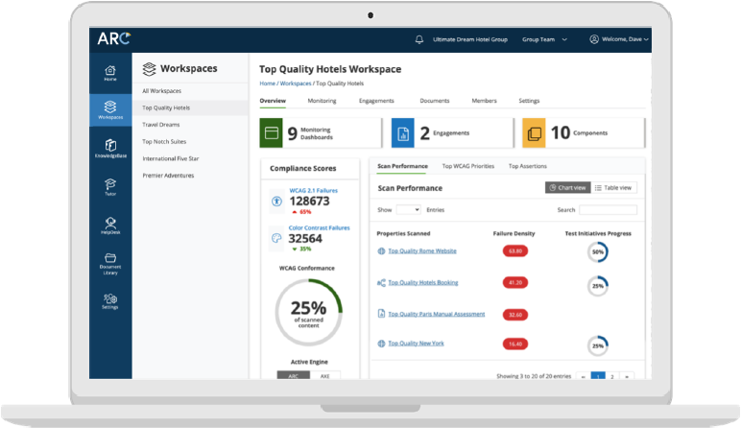
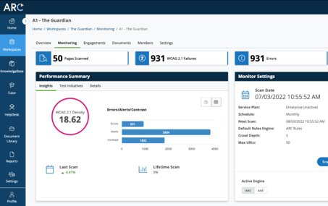
Monitor Your Content to Ensure it is Still Accessible
TPGi’s ARC Monitoring is an easy way to scan your website for accessibility issues and track fluctuations

Slide 38

Accessibility Training for Your Team
If you are developing your digital assets, make sure your teams are trained in accessibility.
Training for web developers and content creators
Accessibility awareness and etiquette training

Slide 39
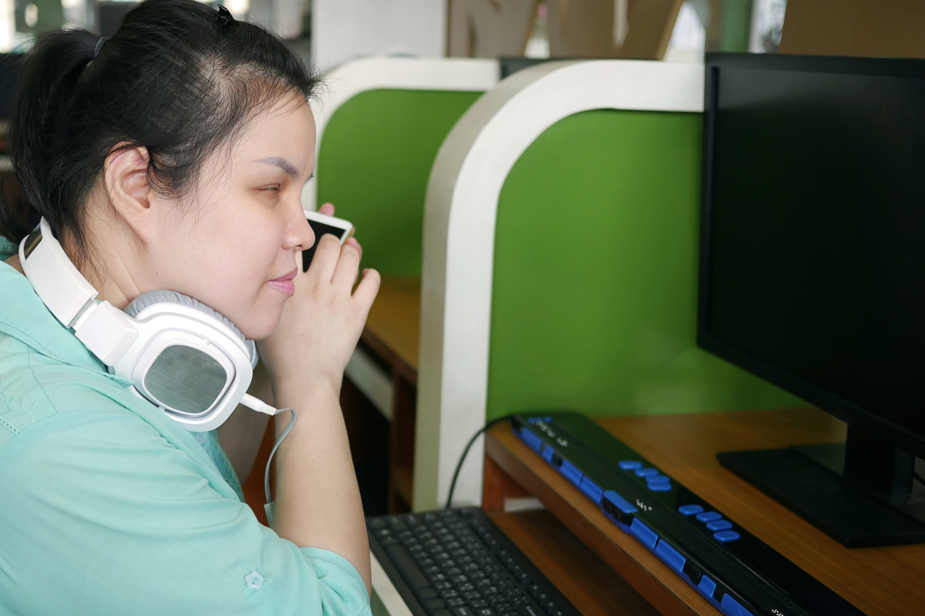
Collect Customer Feedback
Test the usability of your website, mobile app, self-check out POS system with people with disabilities

Slide 40
More Proactive Strategies
Require WCAG 2.1 AA Compliance in contracts for web development and reservations services
Create Accessibility Statement
Third party content
24/7 telephone line

Slide 41
Kiosks for Ordering & Payment – Legal Landscape
DOJ Statement of Interest
lawsuit about inaccessible self-check-in kiosks at diagnostic labs
employee assistance for inaccessible kiosks does not satisfy the ADA because of lengthy wait and loss of priority in line
NFB v. Walmart, D.Md. Case. No. RDB-18-3301 - inaccessible self-check-out devices do not violate the ADA because Walmart employees provided assistance.
Williams v. McDonalds (ED Cal 2022) – inaccessible ordering kiosk at McDonald’s does not an ADA violation because employee assistance provided.
West v. Moe’s Franchisors (SDNY 2015) – inaccessible soda dispensing machine not a place of public accommodation and no evidence that employees failed to provide assistance; no ADA violation found.
Boyer v. Five Guys (SD Cal. 2018) - Five Guys violated ADA and CA statutes by not offering assistance at inaccessible Freestyle soda dispenser. Plaintiff did not have to ask for assistance.
Vargas v. Quest Diagnostics (CD Cal. 2021): Case allowed to move forward and class cert granted because self-service check-in kiosk not blind accessible and inadequate employee assistance.
Bottom line: Employee assistance can be a method of providing access but must be prompt and cannot involve private information (e.g. PIN, health data).
©2023 Seyfarth Shaw LLP. All rights reserved. Private and Confidential
Notes:
assist must be timely and good - minh

Slide 42
Accessible Kiosks – Practical Considerations
Kiosk accessibility design review
Kiosk Hardware review
Kiosk Software review
POS
Kiosk User Testing
Notes:
matt

Slide 43
Drive-Thru Processes
Deaf customers can’t order the menu board
Mobile Apps good option for deaf customers
Service must be provided at window
Effective communication at the window
Pull forward policies
Notes:
minh

Slide 44
Action Items
Start working toward ADA Compliance now​
Scan your website and mobile applications for accessibility barriers​
​Conduct usability tests with people with disabilities​
Can people with disabilities book a reservations on your website/app or 3rd party reservation service?
Check to see if your self-service kiosks are usable by people with disabilities​
Ask your vendors, if the kiosk or POS system is accessible​

Slide 45
Connect with Seyfarth Shaw
Visit the blog: www.adatitleiii.com
Connect with TPGi
Visit TPGi at the National Restaurant Show in Chicago – Booth # 6966
​
Get social:
Twitter​
LinkedIn​
YouTube​

Slide 46
Thank you!
www.adatitleiii.com
©2023 Seyfarth Shaw LLP. All rights reserved. Private and Confidential

